Slide 1
Technical Training
Report

Slide 2
REPORT DEFINITION
The Report Writer tool is used to create reports. However, this is a much more comprehensive tool.
For example: Mumps programming routines may be accessed externally by reports or embedded directly into reports as processors.

Slide 3
Creating a Report Definition
The following are the steps required to create a Report Definition using the Report Writer:
  Name the report being created (up to 12 char’s)
  Complete the Report Writer Control Page screen.
  Make any desired changes to the Report Sequence Definition screen.
  Create and modify the report in the Object Oriented Editor.
  Save the report.
  Compile the report.
  Run the report.

Slide 4
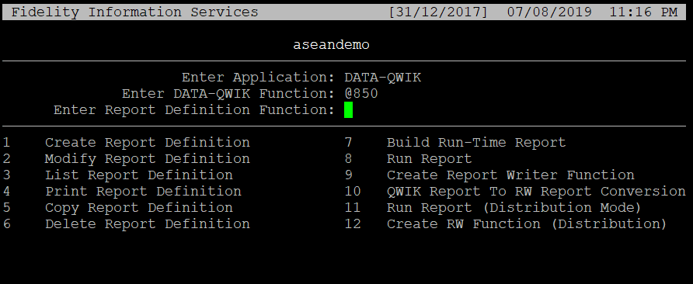
Accessing Report Definition
Report definition access: run a function @850

Slide 5
Accessing Report Definition
The following table shows the Report Definition maintenance functions by function ID (these may be entered from any menu)
Description | Function ID
Create Report Definition | DBSEXEC
Modify Report Definition | DBSEXEM
List Report Definition | DBSEXEL
Delete Report Definition | DBSEXED
Copy Report Definition | DBSEXECO
Build Run-time Report | DBSEXEB
Run Report | DBSEXER
Create Report Writer Function | DBSEXEFN

Slide 6
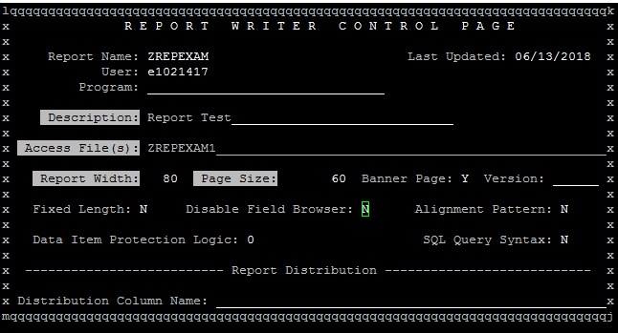
Creating a Report

Slide 7
Creating a Report
Description - Enter up to 40 characters that will identify the report. The description the user enters here will appear in the standard report header and on lists of reports.
Program - The name of the compiled run-time program for this report. This will be blank until the report is compiled.
Access Files - The files to be used for the report. To use more than one file, first enter the name of the PRIMARY file, next enter the name or names of secondary files. Separate file names with commas.
  The Access Key of a secondary file must be an Access Key or Data Item in the primary file or in a preceding secondary file for a valid primary/secondary file relationship. The system will verify the primary/secondary file relationship. If the relationship is not valid, one of the following error messages will display:
Report Width - Establishes whether the report is displayed in the 80-column mode, or the 132-column (compressed) mode when it is displayed on the screen. Enter 132 to display the report the compressed mode.

Slide 8
Creating Reports (cont.)
Page Size: - The length of the page in number of lines. A page break will be inserted after this number of lines. For NO PAGE BREAK (such as a report that will be copied to a tape), enter 99999999. Default = 60.
Banner Page - A logical field: Y - Print a banner page before the report. The banner page includes a summary of the Report Definition and details about the print run such as User ID, date, and time. An Institution Variable Data Item to print banner pages must also be set to YES for banner pages to print.
  N - Does not print a banner page. First page printed is the first page of the report.
Version - This is an optional field for entering the version of the software. It is used for informational purposes only

Slide 9
Creating Reports (cont.)
Fixed Length: - A logical field:
  N - For standard columnar reports in which numeric data is right aligned and text data is left aligned.
  Y - For a report that uses data in a fixed-length format. This field is used for reports that will be copied to tape. This option will pad each record with spaces to make the record length equal to the value in the REPORT WIDTH field. The fixed-length formats pad numeric fields to the left with zeros and pad text fields to the right with spaces.
For Disable Field Browse - A logical field:
  Y - To create a report display that will is read-only. Users will not be able to move the cursor into the report.
  N - To create a report display that can be read or modified. Users will be able to move the cursor into the report to view data, or to use the browser cut and paste feature.

Slide 10
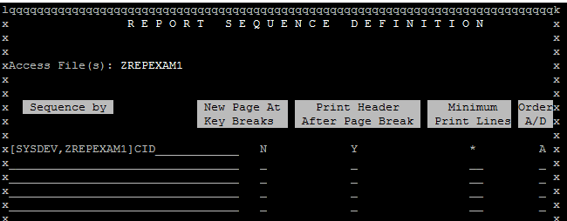
Report Sequence screen
Pictured below is the Report Sequence Definition Screen. This screen determines how the report will be ordered. The default order is determined by the Access Keys of the primary file listed in the Access File(s) field. This order can be modified to accommodate other sorts; however, all Access Keys of the primary file must be included.

Slide 11
Report Sequence (cont.)
Access File(s) - These files are defaulted from the Control Page and protected.
Sequence By - The report is sorted by the Data Items listed. The Access Keys from the Primary Access File are listed by default.
  To change the sort order, add the Data Item to be used as a sort key to this list. The additional Data Items must be included with the default keys.
New Page at Key Breaks - Enter a Y to start a group section on a new page. Enter an N to print each group section without breaking to a new page.
Print Header After each Page Break: - Enter a Y here to print group headings at the top of every page. Enter an N here to print group headings only when the group changes.
Minimum Print Lines - Enter the number of lines to be printed at the bottom of a page before the report breaks to a new page. The default is “*”. The Minimum Print Lines value for the default is the number of lines in the Detail Section of the report.
Order A/D - This field applies to the corresponding Sequence-by Key. A response of “A” would sort the key in ascending order. A response of “D” would sort the key in descending order.

Slide 12
Report Editor
After completing the Report Sequence Definition screen (Order By page), the system will provide an Object Oriented Editor (OOE) layout screen where the report is designed.
The Object Oriented Editor (OOE) is considered a WYSIWYG editor (What You See Is What You Get). In other words, the report will appear at run-time exactly as it does in the OOE.
The OOE layout screen is divided into four sections Separated by markers. Regardless of the key structure on the Report Sequence Definition screen, the system will provide the following markers:
Page Header
Report Detail
Page Trailer
Report Summary

Slide 13
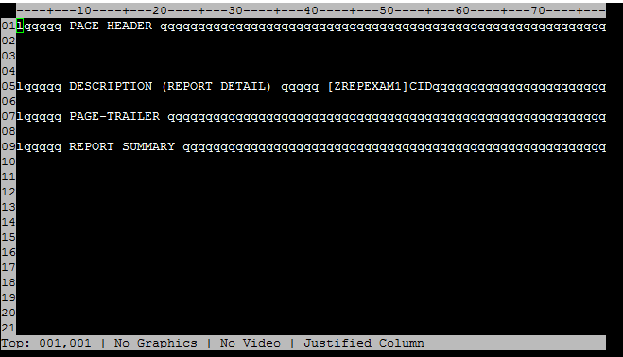
Report Editor

Slide 14
Reports - Keyboard Map
PC Key | Description
Num | Shift key to modify another action key, as described above.
/ | Insert a field or data item at the cursor location.
* | Move current line
Num-* | Move current object
- | Delete current line
Num-- | Delete current object
0 | Access report writer functions, e.g. save, compile, run, etc.
Num-0 | Access report writer commands/features, e.g., blank line suppress, line feed suppress
1 | Select group of objects.
Num-1 | Un-select selected objects.
2 | Go to a specific XY coordinate.
Num-2 | Buffer manager
3 | Enter command.
Num-3 | ZSYSTEM command to access shell

Slide 15
Reports - Keyboard Map
4 | Select heading style, or turn off automatic headings. Unless turned off, when a column is added as a field, the column's report heading (DBTBL1D.RHD) value is inserted as a heading.
Num-4 | Change the case of selected objects.
5 | Select style for fields on entry - relevant for screens, not reports.
Num-5 | Select size for field - relevant for screens, not reports.
6 | Insert graphic character - relevant for screens, not reports.
Num-6 | Insert frame - relevant for screens, not reports.
7 | Toggle ruler
Num-7 | Toggle 80/132 column width
8 | Move to prior object
Num-8 | Move to end of current object
9 | Break a literal object at the cursor position
Num-9 | Join selected objects
period | Exit editor
Num-period | Save report/screen

Slide 16
Reports - Keyboard Map
+ | Resets various options to default values
enter | Access report writer sections, e.g., control page, order-by page, etc.
Num-enter | Quick layout options
Hom | Find string
Num-Ins | Find data
Ins | Insert buffer
Del | Remove
Num-PgUp | Select all objects
End | Select current object
Num-Del | Select group of objects
PgUp | Pan up, i.e., move cursor up 1/2 of the screen
Num-End | Home - move cursor to top left corner of screen
PgDn | Pan down, i.e., move cursor down 1/2 of the screen

Slide 17
Reports - Keyboard Map
Num-PgDn | End - move cursor to bottom right corner of screen
Arrow keys | Move cursor up, down, left, right
Num-arrow keys | Pan up, down, left, right, i.e., move cursor 1/2 of the screen in selected direction
PrScr | Display graphic of key mapping
Pause | Report writer functions, i.e., command, file, edit, format, print, select
F11 | Escape/quit
Tab | Move to next object

Slide 18
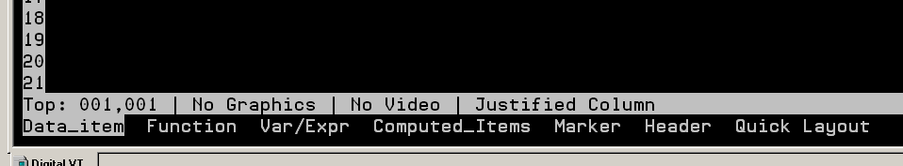
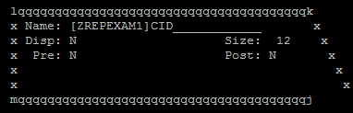
Adding data item
Data Item - Places Data Items on the report.
Data Items may be accessed from any one of the access files.
If the item appears in more than one file, DATA QWIK will prompt the user to select a specific file.
Key used: / (Numeric Keypad)

Slide 19
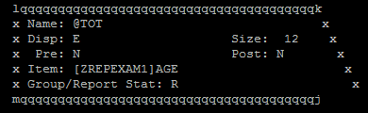
Adding functions
Function - Selects a function to be placed in the OOE.
Function | Description
Total | Total of a numeric or currency field
Count | Count of the items in a group or report
Minimum | Minimum of the items in a group or report
Maximum | Maximum of the items in a group or report
Average | Average of the items in a group or report

Slide 20
Variable/Expression
Variable/Expression - By selecting this option, users can enter any of the existing variables listed below or create a variable by depressing the Other key.
Variable/Expression | Description
Other | User defined variable
Run_Date | Date being run
System_Date | Date of System
Time | Time of System
Page | Page Number
Report_Name | Report Description
Report_ID | Report Identification (e.g. SCA034)
Inst_Name | Name of the Institution (from Inst. Variables)

Slide 21
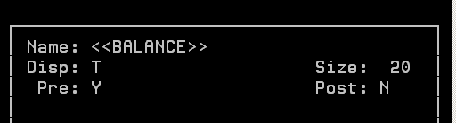
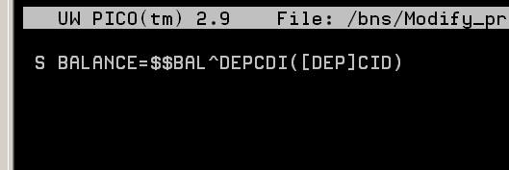
Creating a variable outside of file
Select Var/Expr from menu
Modify pre processor to set the variable’s value.
Note: one space from the margin is required in the pre and post processors.

Slide 22
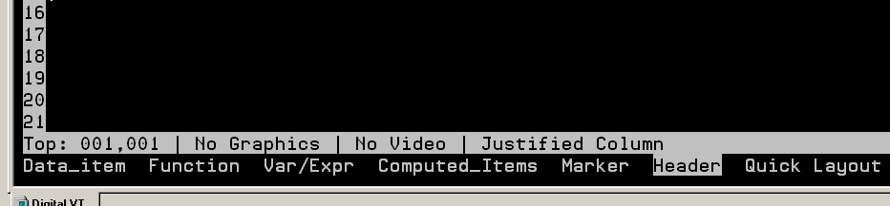
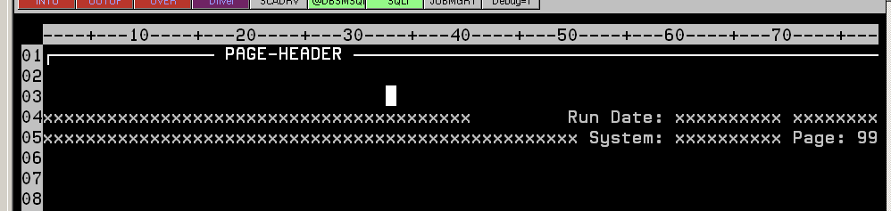
Adding Header information
Select Header from list to insert default header information
The following will be inserted:

Slide 23
Quick Layout
Quick Layout - The system will create a default report layout based on the Data Items entered at the prompt.
Only Data Items can be entered in this method
Qwik Layout is used when converting Qwik Reports to Report Writer reports.

Slide 24
Blank Line Suppress
In some instances, certain Data Items may contain no data or are blank. When a report attempts to retrieve data and there is none, a blank line will be returned and displayed on a report.
DATA-QWIK’s Report Writer contains Blank Line Suppress functionality. This functionality allows users to suppress blank lines. In other words, ‘do not display Data Items that contain no data. This will eliminate unintentional blank lines in a report.
To suppress blank lines while in the OOE of Report Writer:
  Select Blank_line_suppress.
  The user will be prompted to enter a line number (for suppressing a single blank line) or a range (from-to).
  Enter the line number or numbers following the ruler on the left hand side of the OOE. Use a comma to list a series of line numbers and a hyphen for a range of line numbers.

Slide 25
Prompts and Queries
Report Writer has the functionality to create dynamic reports. This is accomplished with Prompt/Queries.
Prompt/Queries consist of a subject, an operator, and a value. There are three different ways to express a prompt or query, depending on how the prompt is appear to the user:
Queries
Queries are fixed conditions specified using the DATA-QWIK query syntax. This requires entry of column in the [TABLE]COLUMN syntax, and operator, and an operand. The table must be one of the tables specified for the report on the control page. The operand may be a literal value or a variable. Variables are indicated using a syntax of <<variableName>>. Multiple operations on the same line are allowed.
For example:
[DEP]CID>1000 - select all accounts from DEP that are greater than 1000

Slide 26
Prompts
In contrast to queries, which are fixed, prompts provide a means to get input from the user at run time.
For example, a report is required to show all history records for an account between a variable set of dates. In this case, three prompts would be used, one to ask for the account number, one to ask for the "from" date, and one to ask for the "to" date. The input to these prompts, at run time, would result in the creation of a SQL WHERE clause that would then be used for the report.
There are two types of prompts –
single wildcard
double wildcard

Slide 27
Prompts (cont.)
Single Wildcard Prompt
A single wildcard prompt requires that the developer specify the [TABLE]COLUMN and the operator when defining the prompt. For example, column [DEP]BAL =, or [DEP]BAL <=. The user, at run time, is expected to enter a single value for the operand, in the case of either of these examples, a single amount to be used.
A single wildcard prompt is entered as [TABLE]COLUMN operator <<*>>, e.g., [DEP]BAL > <<*>>

Slide 28
Prompts (cont.)
Double Wildcard Prompt
A double wildcard prompt requires only that the [TABLE]COLUMN be specified when defining the prompt. Both the operator and the operand are entered at run time. This allows prompting for an account number for instance, and at run time the user can enter "=100" or ">100 and <200".
A double wildcard prompt is entered as [TABLE]COLUMN <<**>>, e.g., [DEP]BAL > <<**>>

Slide 29
Prompts (cont.)
Prompt for Variable
A prompt can also require input of a value for a variable that will be used during report processing either in pre-/post-processor code or in further construction of a query.
A prompt for a variable is entered as &<<variableName>>, e.g., &<<toDate>>

Slide 30
Prompts Qualifier
The report writer will generate a UTLREAD prompt to display at run time for each of the prompts entered.
The attributes of the prompt are determined based on the column name specified or qualifiers that are entered with the prompt definition.
If an overriding qualifier is not provided, the column definition attributes are used. Qualifiers are entered after the asterisks of a wildcard or after a variable, e.g.:
  [DEP]BAL > <<*/DEF=100>> - provide a default value, which will be displayed when the prompt screen is displayed, of 100
  [ACN]ODT <<**/PRO=Date Opened>> - provides a prompt of "Date Opened" instead of "Date Account Opened" from the ACN.ODT column definition
  &<<toDate>>/FOR=D/LEN=10/PRO="To Date"/REQ=1 - indicates the format is "D" data type for date, length allowed for data entered is 10, provides a prompt, and indicate input is required.

Slide 31
Prompts Qualifier
The following qualifiers are available. As shown in the examples, they can be shortened to a unique qualifier name
  FORMAT or TYP - valid DATA-QWIK data type. If not provided for a variable, T is used.
  LENGTH - maximum length of input allowed.
  DEFAULT - default value to display when the prompt screen is displayed. For double wildcard queries, the default value is "ALL".
  HELP - column to use for on-line help.
  TABLE or TBL - look-up table.
  PATTERN - pattern match.
  PROMPT - prompt to display.

Slide 32
Prompts Qualifier
  REQUIRED - 1 to indicate a value must be entered, 0 otherwise. The default is 0 except for single wildcard prompts, which automatically require input, with a default value of "ALL".
  POST - prompt post-processor code. This code must be written in M, not PSL. The input value is available in the variable X. A common use of this code is to validate the input. Setting ER=1,RM="some message" will cause the screen handler to indicate an error, display the message, and not allow input to move past the prompt.
  PRE - prompt pre-processor code. This code must be written in M, not PSL. A common use of a pre-processor is to set up an array to be used as the value for the look-up table.
  MINIMUM - minimum value
  MAXIMUM - maximum value
  DECIMAL - decimal precision

Slide 33
Prompts Qualifier
Example
Instead of prompting with the description field of a data item.
Use <<**/PRO=>>
[DEP]CID <<**/PRO=Enter Account>>
Enter Account:
Set a default value prompt other than “ALL”
Use <<**/DEF=>>
Example:
  [XCLS]GRP <<**/DEF=“MTG”>>
  Account Group is equal to: MTG

Slide 34
Report Writer Functions
In Profile functions allow users to perform tasks without having to search through several menus because functions can be entered from any menu in the system.
A function may be created which will allow a user to run a report from any menu in Profile. The Create Report Writer Function (DBSEXEFN) utility is used to accomplish this.
The following are the field descriptions for the fields located on this screen:
  Report Name - Name of the report that the function will access.
  Function Name - The name of the function. It is recommended to give the same name to the function as the report, but no required.
  Function Description - A free-form text field to provide a description for the function.
NOTE: The report must be recompiled after a function is created.

Slide 35
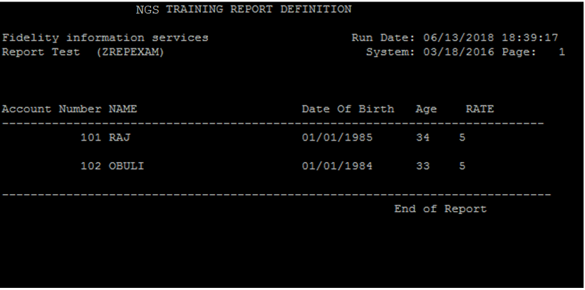
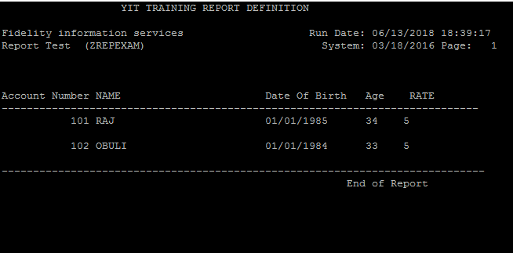
Exercise
Create report with the layout as shown below
Access file: ZCUSTxxx table (created before)
This report should display records from ZCUSTxxx table as shown below

